Slide 1

College Update
Winter 2016
February 26, 2016
Notes:
Thank you for joining us for the College Update for Winter Quarter 2016.
Emergency Exits are located at the bottom of the room on both your right and left and then proceed out the building to an identified evacuation site.
Let’s review the agenda…

Slide 2

Today’s Agenda
Welcome
Shoreline Successes
Vision, Mission,
and Strategic Plan
New Allocation Model
Enrollment
Questions
Key college initiatives
Notes:
Thank you so much for coming today. We have a full agenda today with important information for all the campus community. This is my third Campus Update meeting since I joined the college nearly 18 months ago. Together, we have accomplished much in these months and I want to hear from you today about your successes to date. You remember the Wordle we created at Convocation? It is time to update it with words from you, so we'll start out today with that.
Secondly, I want you to hear the results of your work on the Strategic Plan. We are going to finalize the plan next month, and then begin the annual planning on the steps we need to take to achieve the goals. The Board of Trustees has reviewed our Vision and Mission and made important changes, which came from our campus community.
Thirdly, the new allocation model from the state requires us to adjust our focus, and I want you to hear from Dawn Vinberg about the implications for our revenue and from Bob Francis and Diana Sampson on enrollment.
Finally, there are key initiatives underway, and you need the most up-to-date information from Bob, Stuart Trippel, and Dawn.
Together, we are coming to closure on defining our goals, demonstrating our resiliency, and continuing to drive for academic excellence in all that we do. We have the most important work ahead, and we are the right people at the right time. It’s our energy and passion that propels us all forward.
So let's start with what makes Shoreline great.

Slide 3
Shoreline Success
What makes our college great?
Notes:
Take a moment to stop and reflect on the work you have been doing. Write down in one sentence what you have accomplished. Then write down one or two words that capture your success.

Slide 4

State of the College
Present position
What drives our work?
In charge of our destiny
Notes:
It’s great to hear all the good work you are doing, and the things you are proud of at Shoreline! Thank you so much.
Now, let's talk about the essential work ahead while paying attention to what drives our work: Passion, Best at, Resources.
We have asked the Clarus company to undertake a detailed analysis of our entire enrollment process from a student's first indication of interest, to the successful completion of her or his goal. We have identified many small steps we must take, and that work is already underway in student services. Clarus also waved the red flag around our college identity: they found that it is not well understood, defined, nor communicated well internally or externally. Since our identity is a critical message about who we are, what we deliver, and meets the students' and communities' needs, we have to make sure we have a crisp, well-communicated message. Think of Nike's "Just Do It", three simple words, but they speak volumes about why you should buy Nikes to reach your athletic goals. You will hear more about this work in campus updates throughout the rest of the academic year.
Our Strategic Plan work has helped us work together to define what we are passionate about, what we are best at, and the resources we have, and need to deliver excellence in all we do. Stuart will bring us up-to-date on the status of that work.
Today's update gives you the latest information about our Allocation model and the goals we have to meet to fulfill our mission. The model has changed and will affect us. However, for the last three years, we have been investing in our student recruiting and retention, which puts us in a strong position today.
We have demonstrated resiliency and commitment. (include matrix idea) The important work ahead has urgency. But we have time if we stay focused and deliver on our strategic plan. We have time, we know and are learning what to do, and we build the capacity through our plan to effectively deliver on our goals.

Slide 5

Vision and Mission
Excellence
Teaching
Learning
Inclusiveness
Diverse communities
Notes:
(Cheryl introduces topic): We launched the Strategic Plan work last year to help us define, and commit to, what we are passionate about, what we are the best at, and what resources we need to accomplish our attainable goals.
Stuart has been leading the work, Laura Rehreman has helped us refresh our vision and mission. Stuart, bring us up-to-date on the status of the work. It is setting a milestone and a course for this college that comes at just the right moment in our history.
(Introduce Stuart).

Slide 6

Strategic Plan
Student Success
Excellence
3 Es:
Social equity,
ecological integrity,
and economic viability
Notes:
Stuart: Review where we are with the plan getting finalized
Prioritizing. This plan helps us prioritize.
Then next steps: strategies have action items, we will develop goal teams (like the student success coordinating committee model), then each goal team will help set the projects and timelines. Involvement by many along the way.
Moving forward in building plans in the same manner as the strategic plan, teams of people, cross-functional input, with task forces and work groups, etc.
BIG DEAL: this is a change. Taking the strategic plan into action! This is a working document that there is a real next step, there is a reason we worked hard on this - - it is a map for the next five years. Will work within the Strategic Planning Budget Council structure.
Back to Cheryl

Slide 7

Confronting the Facts
  New allocation model
    Implications
  Enrollment
Notes:
As you know, we have a new Allocation Model, and Dawn has prepared information so you can all see the implications for our campus. This is the latest information, and although the model will likely be adjusted to a degree, our work on enrollment will be critical. Dawn, what does the Allocation Model imply for us?

Slide 8
Overview
The New Allocation Model
What we know
Key Changes
Student Achievement Initiative Funding (SAI)
Features of the Model
Four-Year Phase-in
Weighted FTES
Three-Year Actual FTES Count
Student Coding (up to 2%)
Designed as responsive and dynamic
Many changes still unknown
Maintenance & Operations
Notes:
Good afternoon everyone.
You may recall our detailed review of the new allocation model last Fall. We are in the midst of our system-wide “learning year” and many of the final components are being analyzed for impact across the system. The model will go into effect Fall of 2016 (this year) and there are still many unknown parts of this puzzle.
The information we have been provided by the SBCTC confirms what we had originally forecast. We need to grow domestic enrollment each year, for the next four years, in order to remain “revenue neutral” once the full model is implemented. Not achieving this growth in our domestic student enrollment will impact Shoreline and we will look at other avenues for revenue, such as increasing International Student enrollment and additional grant opportunities.
Review the components on the slide.

Slide 9
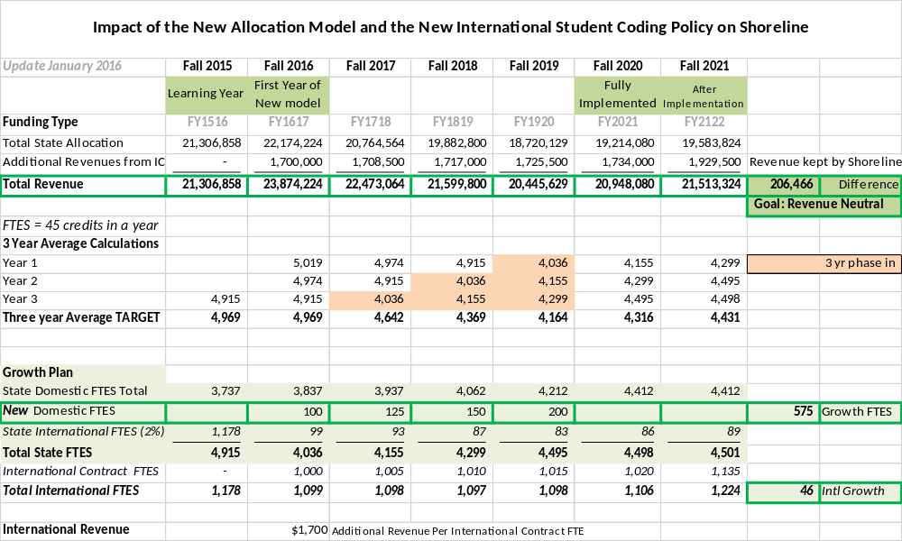
Part 1
Part 2
Part 3
Notes:
Some of you have seen this spreadsheet previously, and I realize it seems like a lot of information. The President wanted to make sure the college community is as informed as possible on this forecast.
Let’s take a few minutes and walk through the parts of this spreadsheet.
Part 1: State Allocation + Additional Revenues from our International Contract students demonstrate that Shoreline performs well in the model for the first year and then over the years of implementation, we need to count all our students and grow domestic enrollment to remain in a revenue neutral position.
Part 2: demonstrates the three year average FTES calculation. The average of three years of Shoreline’s actual enrollment calculations will be used to establish our target FTES the next year. This is where you can begin to see the reduction in FTES calculation as the International Students are moved over to contract coding.
Part 3: a picture of our growth plan is represented by the row with the wide green bars.

Slide 10

Enrollment Trends
  Enrollment –
  all students are
  important
    Domestic
    enrollment
    International
    enrollment
Notes:
Cheryl: what we know is that every single student counts.
Bob and Diana will give you the must current trends.

Slide 11
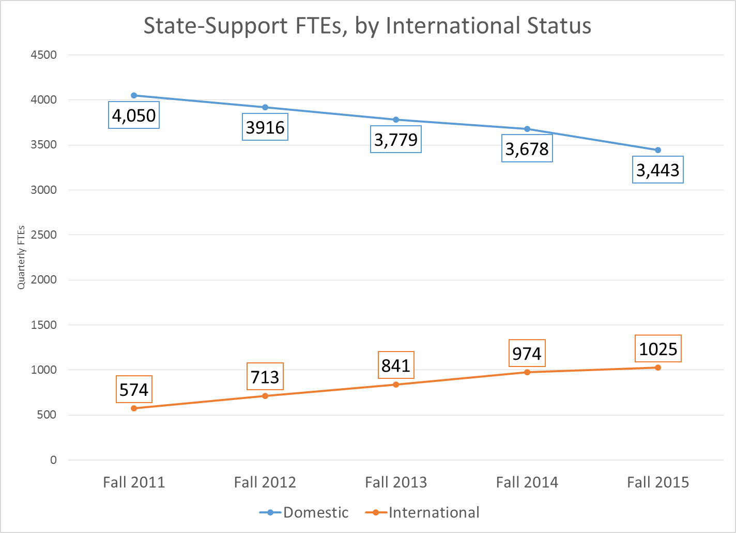

Slide 12
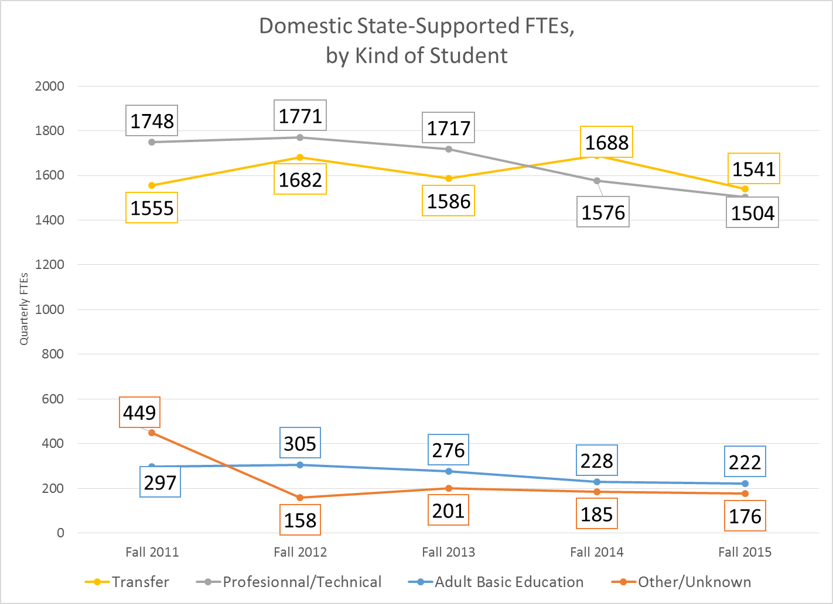

Slide 13

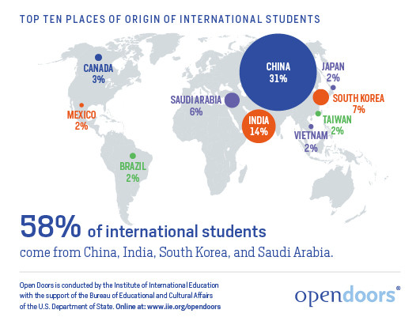
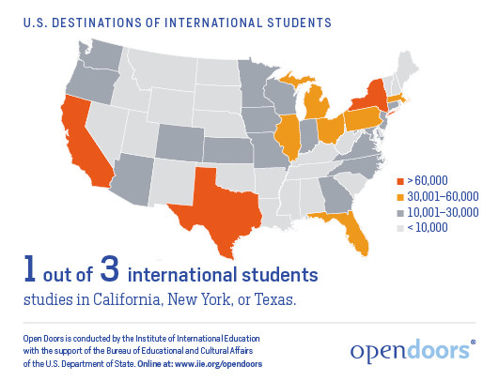
Open Doors 2015 Report
INSTITUTE OF INTERNATIONAL
EDUCATION
Fast Facts
In 2014-15, the number of international students studying in the US increased by 10% to a record high of 974,926 students.
9.4% of all international students in the U.S. attend community colleges.
58% of international students came from 4 countries -- China, India, South Korea, and Saudi Arabia.
Of the top 40 U.S. two-year colleges hosting international students, 8 are from WA State located in the Puget Sound region.
Shoreline placed #22 in the nation and the 5th largest enrollment in WA State.

Slide 14
International Education
1000 international students from 45 different countries are represented at Shoreline.
1000 international students from 45 different countries are represented at Shoreline.

Slide 15

Questions
What additional information
do you need?
  Discuss at your seats
  Share with the entire group
Notes:
Cheryl asks for small group discussion at their seats
Cheryl solicits feedback.

Slide 16

Key Initiatives Focused on Student Success
  College Identity
  American Honors
  AVID for Higher
  Education
  Housing
  Capital and
  Construction Projects
Notes:
Cheryl introduces Bob, Stuart and Dawn for updates on each initiative
We have a number of new initiatives underway. We have invested in experts to help us take a leap, rather than just a step, forward. Bob will you give us the highlights of the instructional initiatives, and then Stuart will brief us on the state of housing and Dawn will discuss capital planning and projects.

Slide 17

Our Response
  Adjust to the new allocation model
  Wisely use the next four years
  Stay focused and work our plan
  Continue to be engaged
  Tradition of resiliency and innovation
Notes:
So where do we stand? We know we have to adjust to a new Allocation Model, and the important thing to remember is, WE HAVE TIME! We have four years to meet the targets. Positive actions yield positive results
Secondly, we have leveraged expert advice and we already have begun implementing enrollment initiatives aimed at growth. We know from the Clarus assessment that we have headroom to grow. We have every reason to be confident that in the four years ahead, we can meet and even exceed the enrollment goals we have set.
With the current initiative you have heard about today, and I am certain the strategies we will set together to implement the Strategic Plan goals, we can help our students finish what they start, and reach THEIR goals.

Slide 18


Notes:
Reveal new Wordle

