Slide 1

Ecological Integrity Surveys
2019

Slide 2
OVERVIEW

Slide 3
Successfully publicized surveys through email, posters, and faculty canvas sites
Students – 594 responded, and 466 completed
  About 6000 students were emailed twice, and one-third opened the email each time
Employees – 292 responded, and 255 completed
  About 750 employees were emailed, and between 45% and 60% opened the email each time

Slide 4
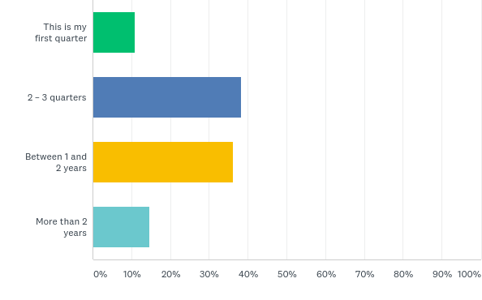
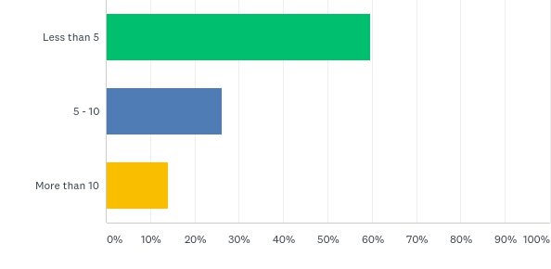

Students
How long have you been at Shoreline?
Hours per week on campus (outside of class)

Slide 5
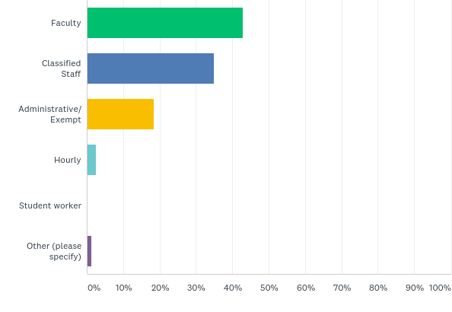
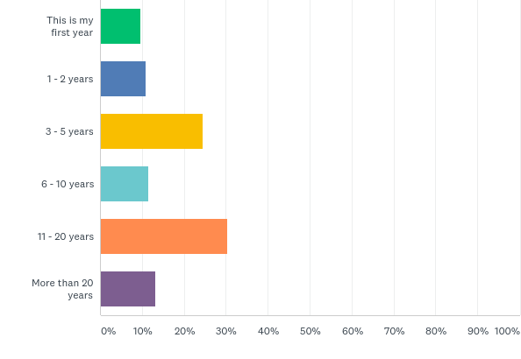
Employees
Employee group
How long have you been at Shoreline?

Slide 6
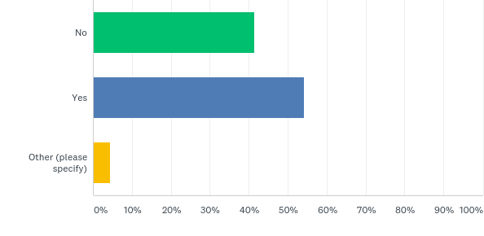
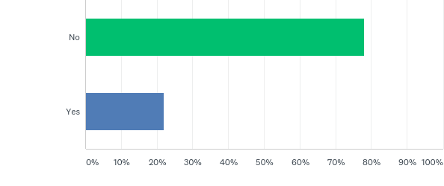
Were you familiar with the “3 E’s” before …
Students
Employees

Slide 7
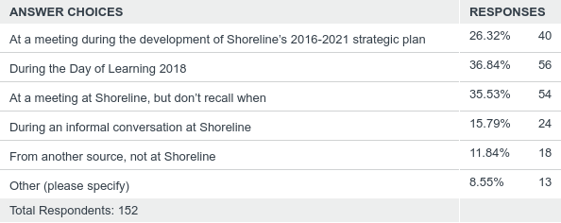
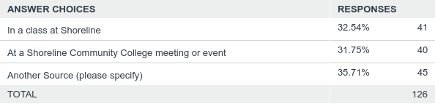
Where did you learn about the “3 E’s?”
Students
Employees
Other sources include high school, other colleges, and from work

Slide 8
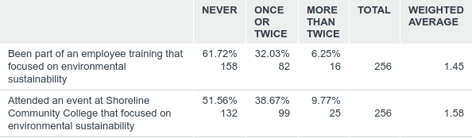
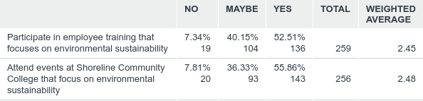
Learning about the 3 E’s - employees
In your time as a Shoreline employee have you…
Do you think there should be more opportunities at Shoreline to … ?

Slide 9
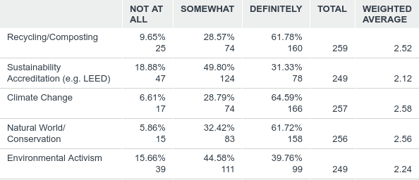
Learning about the 3 E’s - employees
To what extent do the following topics interest you as possible themes for activities or events at Shoreline?
  Climate Change was also a popular topic of interest among students

Slide 10
Curriculum

Slide 11
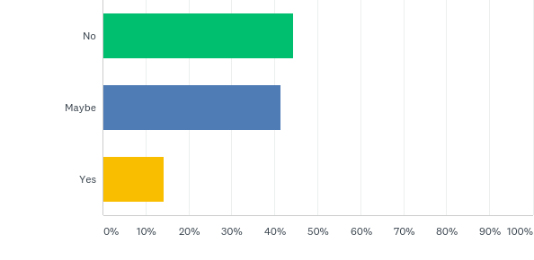
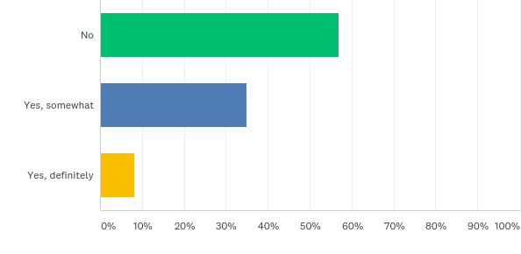
About 40% of employees who responded taught at Shoreline in the last two years. Of those…
Would you be interested in developing a new course that focuses on environmental sustainability?
Do you currently teach a course that includes concepts of the environment or sustainability?

Slide 12
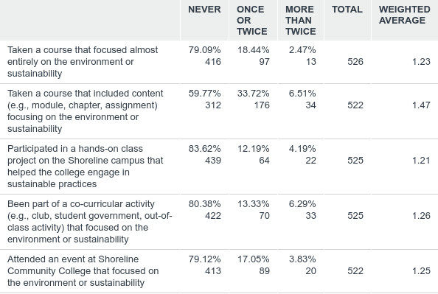
Students - environmental sustainability in the curriculum

Slide 13
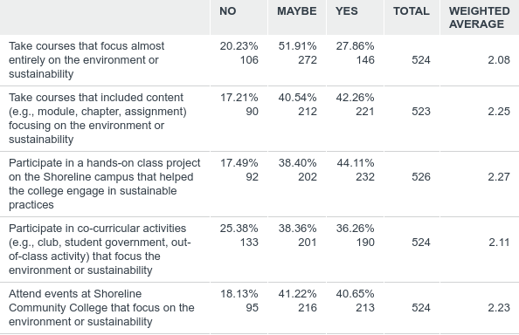
Students would like to…

Slide 14
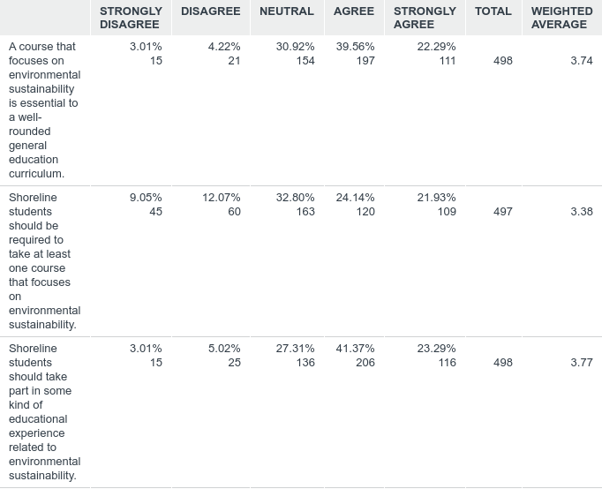
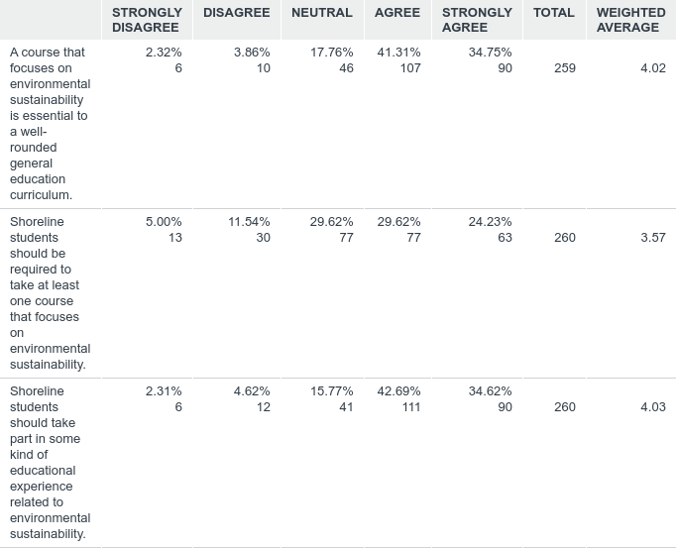
Environmental sustainability in the curriculum
Students
Employees
Notes:
Look at by whether taught in the last 2 years?

Slide 15
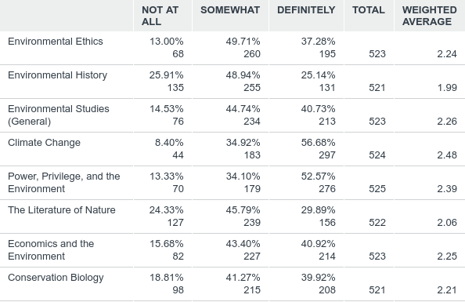
Students – interesting topics for courses, projects or events
  Climate Change was also a popular topic of interest among employees

Slide 16
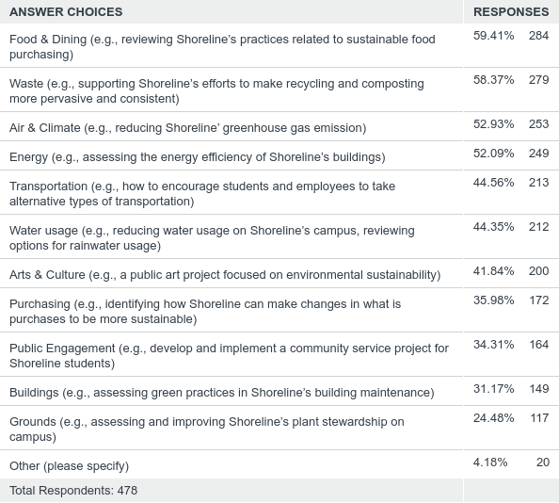
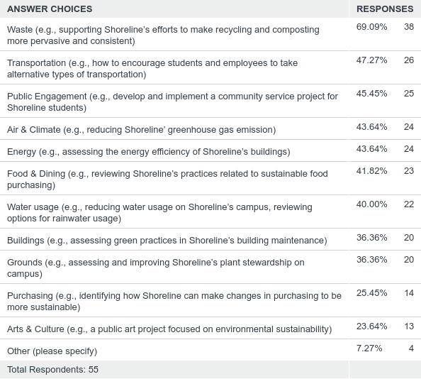
Living laboratory projects (choose 5)
Students
Faculty interested in teaching
Other: arts, ocean, Puget Sound Stewardship,
Weekend events for online students, gardening,
multidisciplinary, native wildlife
Other: EMF pollution, Financial, World Cultures, Job searches

Slide 17
Students – Adequate offerings?
Ecological Integrity Surveys
2019
Transfer
Professional Technical
65% of student respondents planned to transfer (21 % not sure)
8% of students plan to major or minor in a field related to the environment or sustainability (23% = maybe)
  59% found Shoreline provided adequate offerings to some extent
  30% found Shoreline definitely provided adequate offerings
  (no neutral on this question)
35% of student respondents enrolled in prof-tech (19 % not sure)
5% of students plan to enter a career related to environmental sustainability (26% = maybe)
  57% found Shoreline provided adequate offerings to some extent
  29% found Shoreline definitely provided adequate offerings
  (no neutral on this question)

Slide 18
OPERATIONS

Slide 19
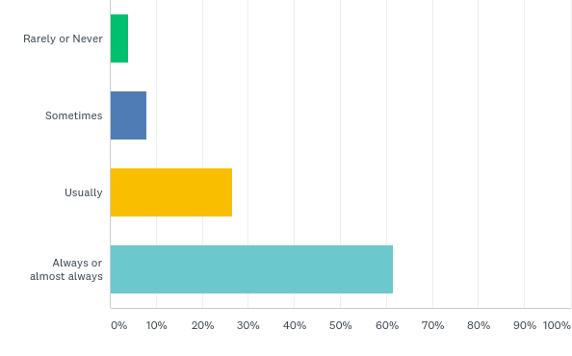
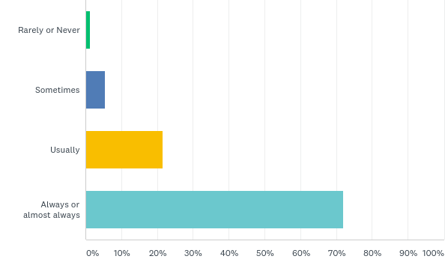
Recycling – How often?
Students
Employees

Slide 20
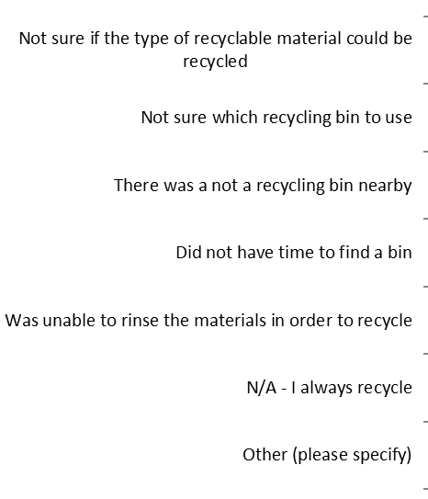
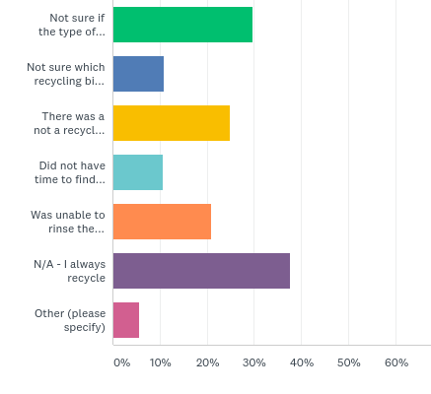
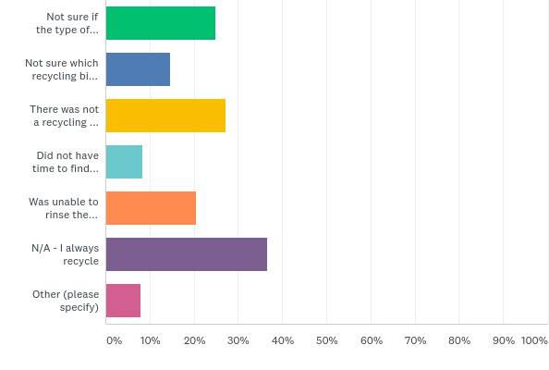
Recycling – Why not?
Students
Employees

Slide 21
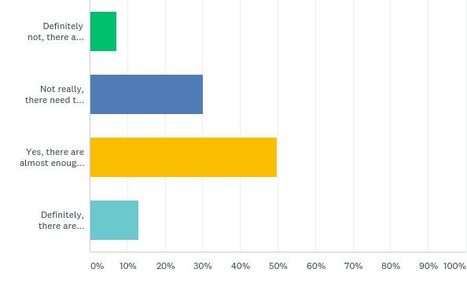
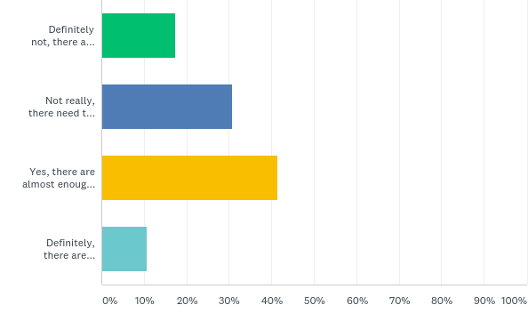
Recycling – Enough Bins?
“there are no recycling/compost bins in the classrooms”
“There [are] limited recycling options in my building”
“I always recycle, but we do not have appropriate bins. I take home what I cannot recycle here.”
Students
Employees

Slide 22
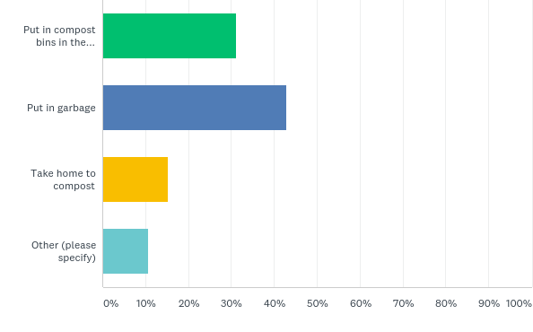
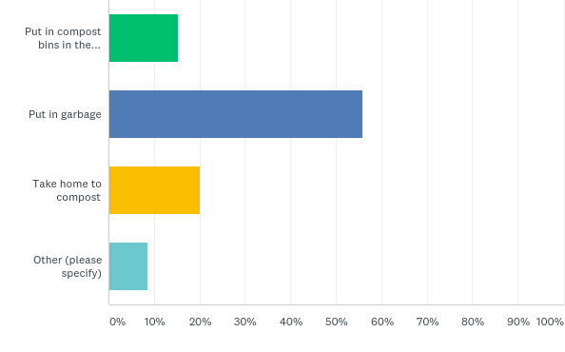
Recycling – With left over food…
Students – 84% would compost more with more bins
Employees – 80% would compost more with more bins

Slide 23
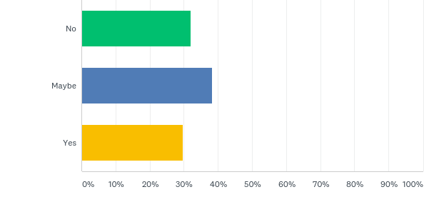
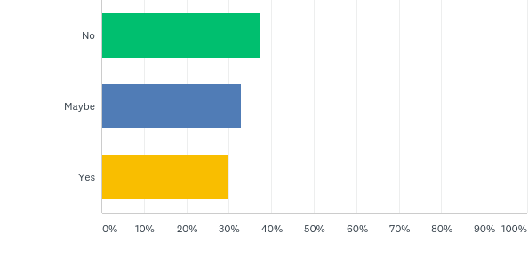
Desire more compost training?
Students
Employees

Slide 24
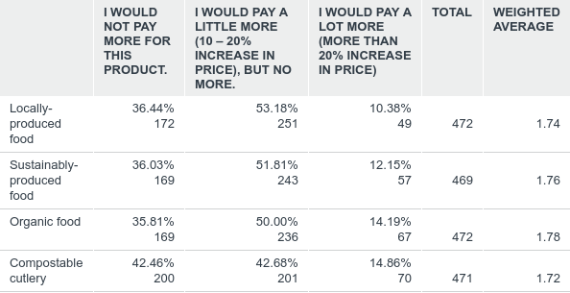
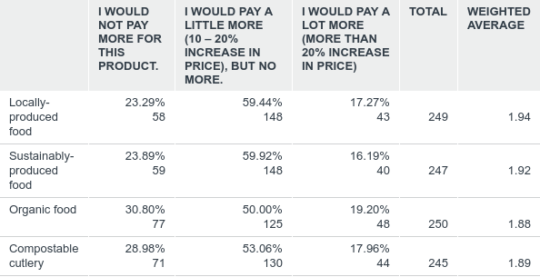
How much would you pay for sustainable dining options?
Students
Employees

Slide 25
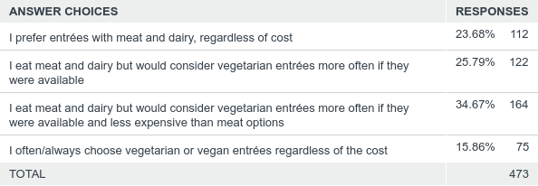
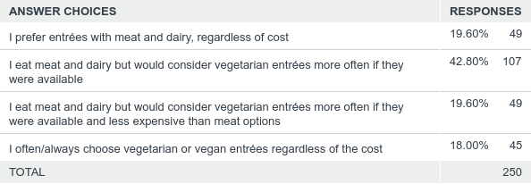
Interest in vegetarian or vegan dining options
Students
Employees

Slide 26
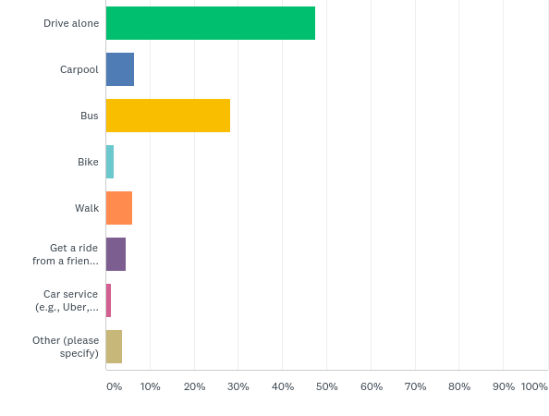
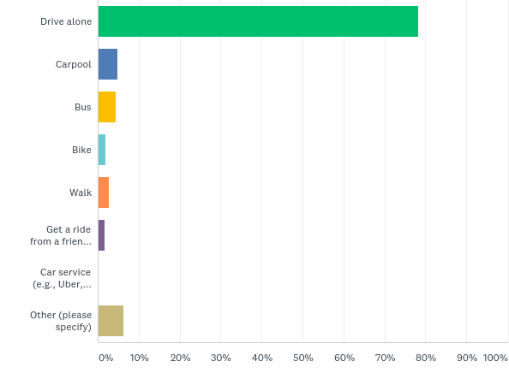
Transportation – typical mode
Students
Employees

Slide 27
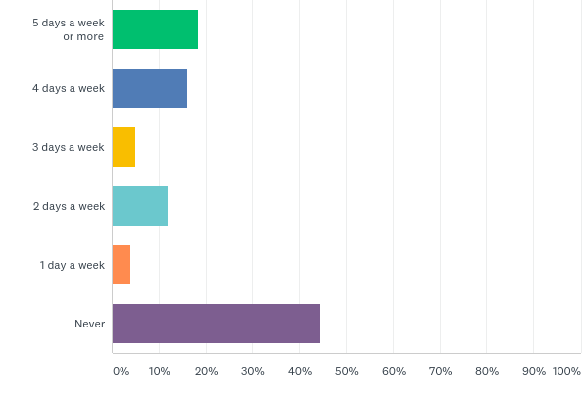
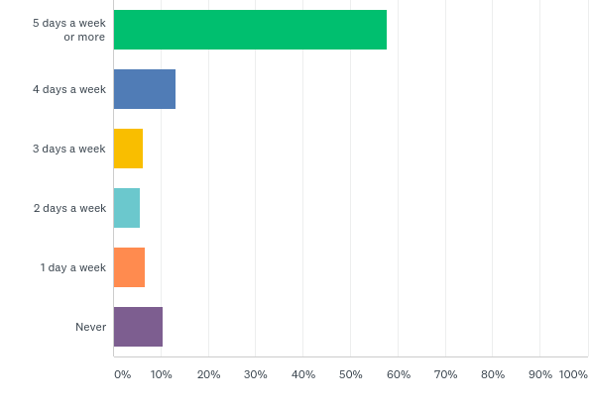
Transportation – frequency of driving alone to Shoreline
Students
Employees

Slide 28
Transportation – frequency of driving alone to Shoreline
Students
Employees

Slide 29
Transportation – motivation to not drive alone to Shoreline
Students (ordered most to least)
Employees (ordered most to least)
Improved bus access to campus, including shuttle bus
  (45% might or would definitely choose alternative)
Assistance with coordinating carpools
More heavily subsidized bus passes
Increase in parking fees by 50% (additional $25 per quarter)
Enhanced sidewalk and pedestrian safety near campus
Better bike routes to campus
Secure bike parking
Access to showers, changing room, and/or lockers
Increase in parking fees by 20% (additional $10 per quarter)
  (39% might or would definitely choose alternative)
Improved bus access to campus, including shuttle bus
  (51% might or would definitely choose alternative)
Subsidized bus passes
Enhanced sidewalk and pedestrian safety near campus
Assistance with coordinating carpools
Better bike routes to campus
Secure bike parking
Access to showers, changing room, and/or lockers
  (27% might or would definitely choose alternative)

